Slide 1
Queue Management System

Slide 2
Introduction
GIS based Queue management system will be helpful to control queues of voters at polling booths/stations.

Slide 3
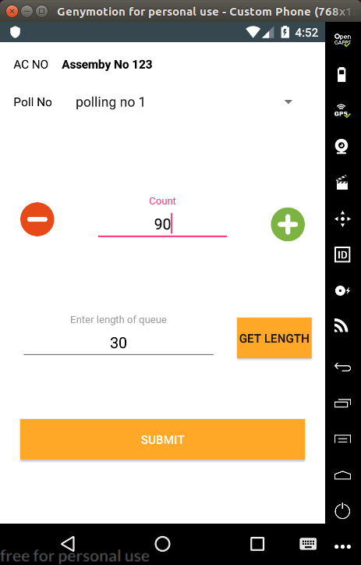
Dashboard Queue Observer
Observer will get Length measurement screen.
Length of queue will be inserted automatically in proper place.
Observer can Increase or decrease no. of person standing in queue using proper button.
Upload status of queue

Slide 4
Dashboard Citizen
Voters will be able to know the current status of polling queue.
Voter will send epic number.
Updated queue status will be sent to voters.

